Slide 1
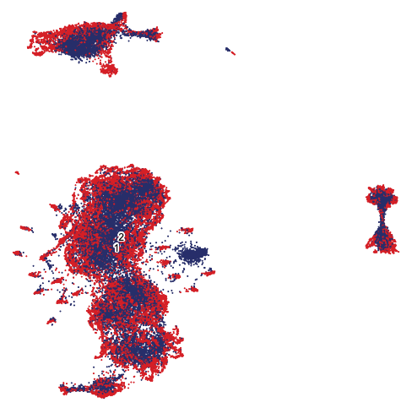
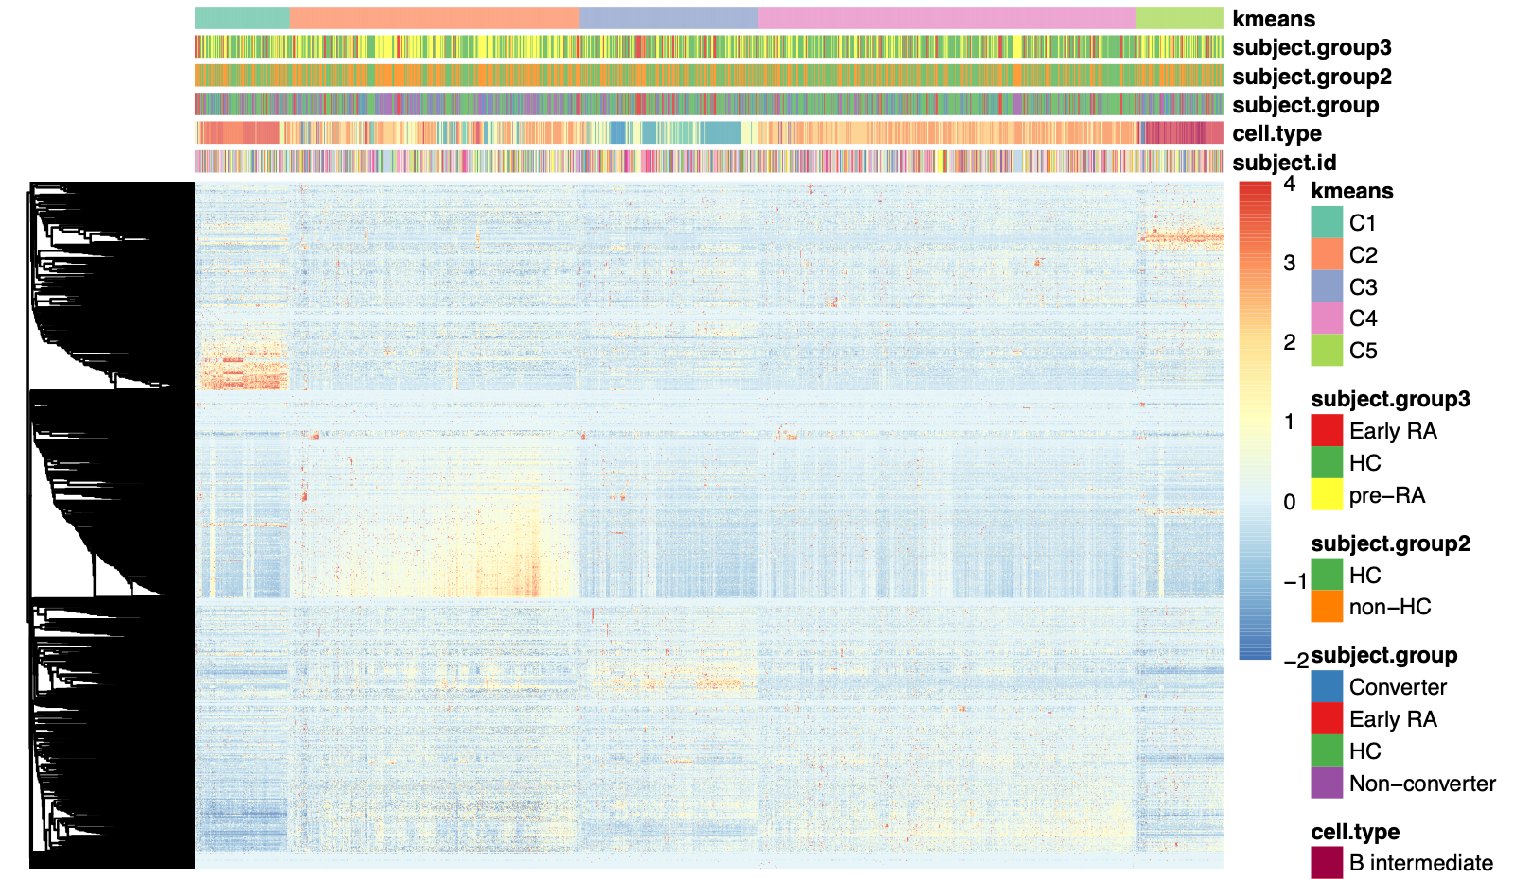
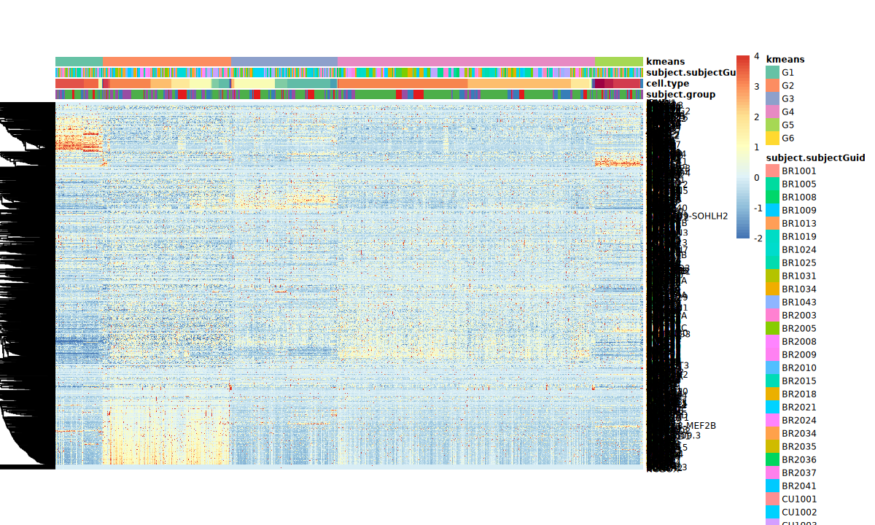
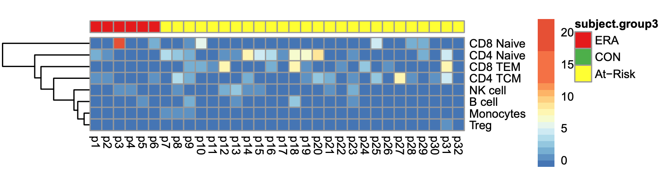
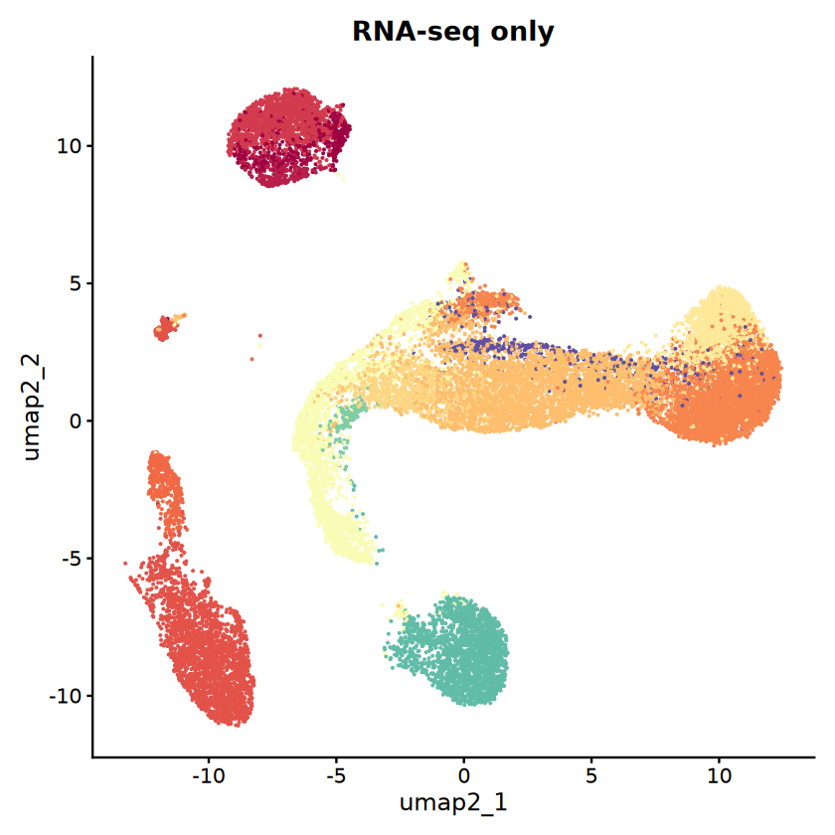
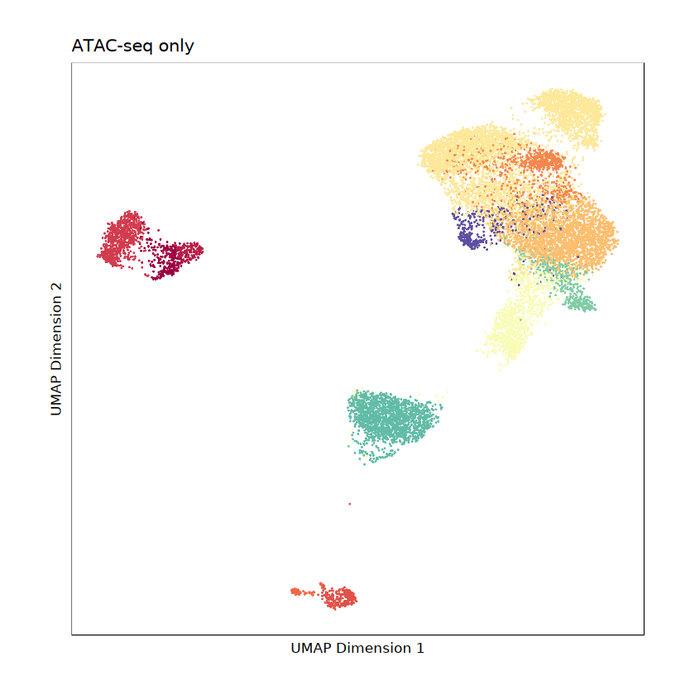
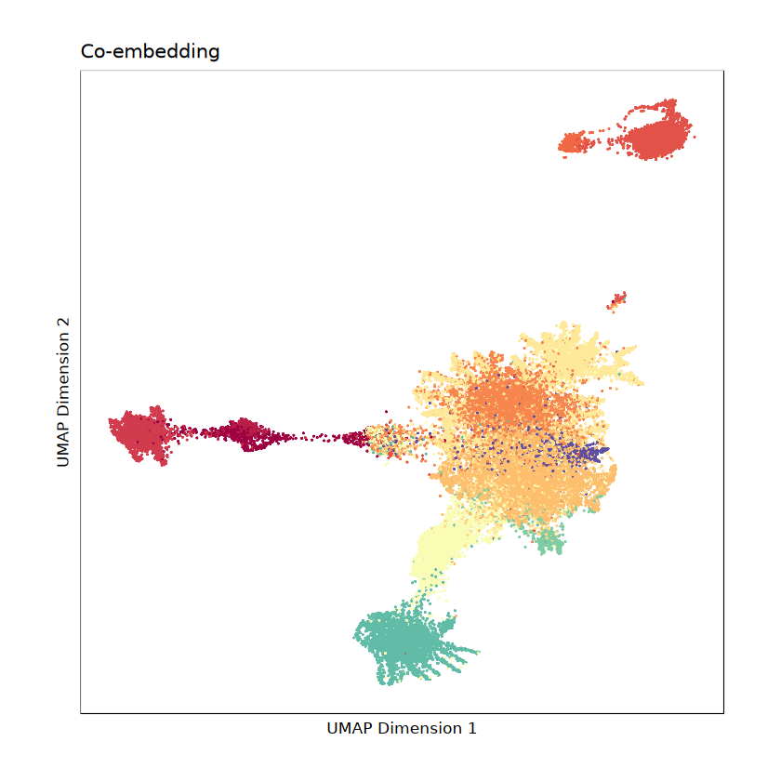
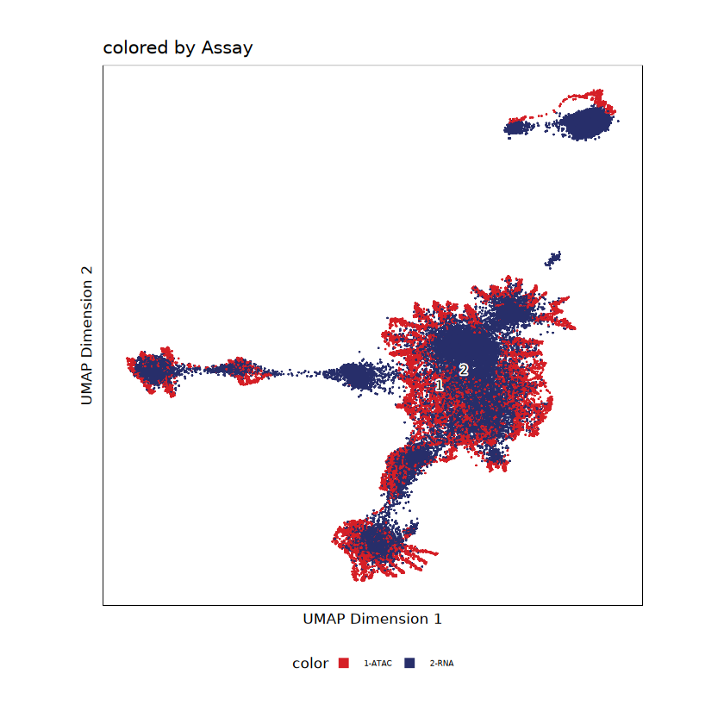
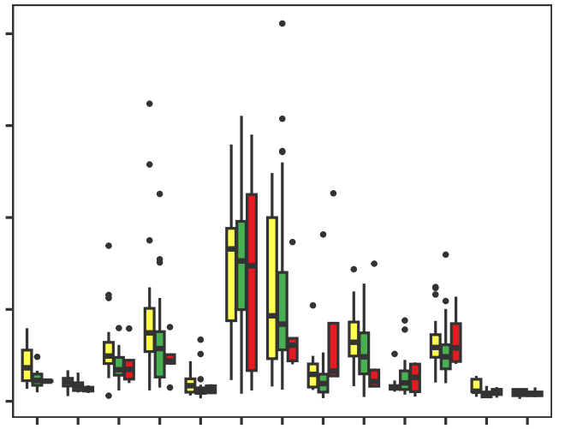
A
Study workflow
scTaiji
Downstream analysis
Datasets
1. Co-embedding
1. Unsupervised clustering shows At-Risk/ERA signature
B
naive
CD14 Mono
CD4 T Naive
At-Risk/ERA enriched group
Control enriched group
CD16 Mono
RNA
67 PBMC samples
35 Control
26 At-Risk
6 ERA
B
memory
CD4 TCM
CD8 TEM
ATAC
Treg
NK
CD8 T Naive
2. Aggregate cells
TF activity score
MAIT
gene count
2. At-Risk/ERA signature across multiple cell types
cell
2
0
3
1
1
0
0
2
1
2
0
4
0
1
3
2
4
5
3
ERA
At-Risk
scRNA-seq (n=67)
scATAC-seq (n=67)
CD8 T Naive
CD4 T Naive
CD4 TCM
CD8 TEM
NK
B cell
Treg
Monocytes
3. Predict TF activity score
# of clusters
D
Percent of cells across cell types
B
scRNA-seq and scATAC-seq of one At-Risk sample
cell types | % of cells
B intermediate | 1.83
B memory | 1.38
B naive | 8.47
CD14 Mono | 11.06
CD16 Mono | 1.80
CD4 T Naive | 25.72
CD4 TCM | 21.31
CD8 T Naive | 3.47
CD8 TEM | 10.33
MAIT | 2.46
NK | 10.73
NK_CD56bright | 0.58
Treg | 0.29
Others | 0.56
scRNA-seq only
scATAC-seq only
B intermediate
B memory
B naive
CD14 Mono
CD16 Mono
CD4 T Naive
CD4 TCM
CD8 T Naive
CD8 TEM
MAIT
NK
NK_CD56bright
Treg
UMAP 2
UMAP 2
UMAP 1
UMAP 1
C
Co-embedding of scRNA-seq and scATAC-seq in one At-Risk sample
Co-embedding colored by cell types
Co-embedding colored by assay
E
Cell type distribution across groups
scATAC-seq
80
CON
scRNA-seq
60
At-Risk
Percent of labelled cells
ERA
UMAP 2
UMAP 2
40
20
*
B intermediate
B memory
B naive
CD14 Mono
CD16 Mono
CD4 T Naive
CD4 TCM
CD8 T Naive
CD8 TEM
MAIT
NK
NK_CD56bright
Treg
0
**
*
UMAP 1
UMAP 1
Notes:
B111_PB00443: CU1033, at-risk, converter
Fig.1D: legend, if there’s difference between three groups, data for each group, can be a table
**p<=0.05, Kruskal-Wallis test

Slide 2
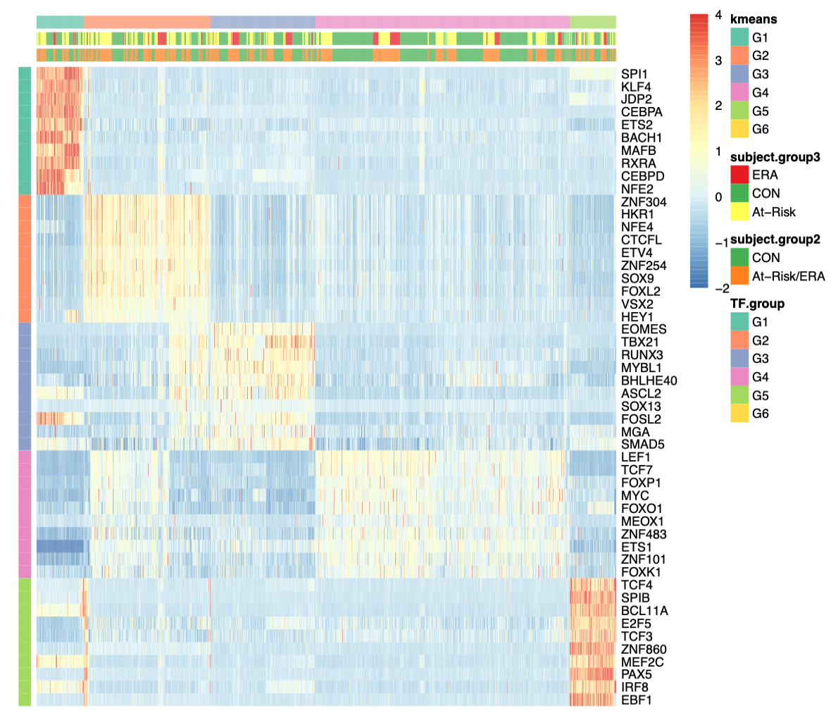
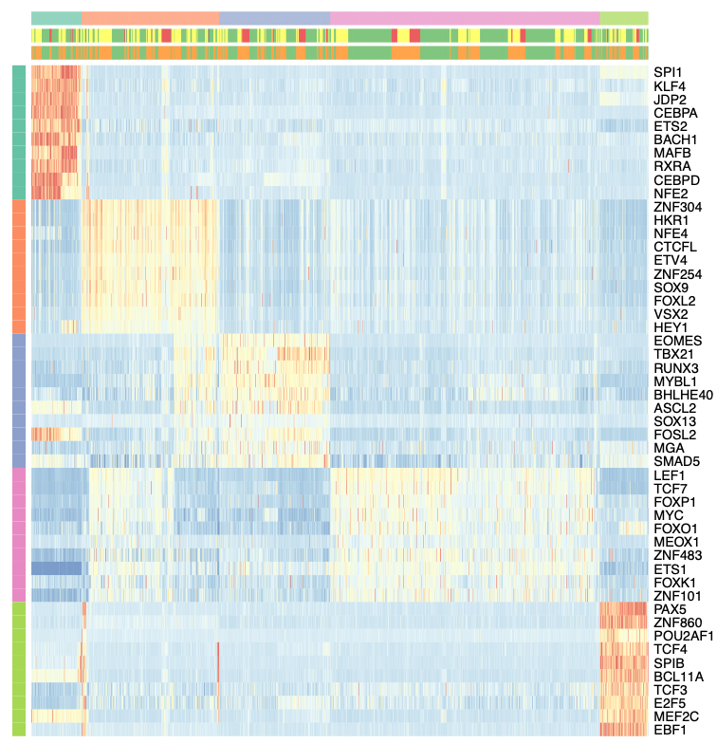
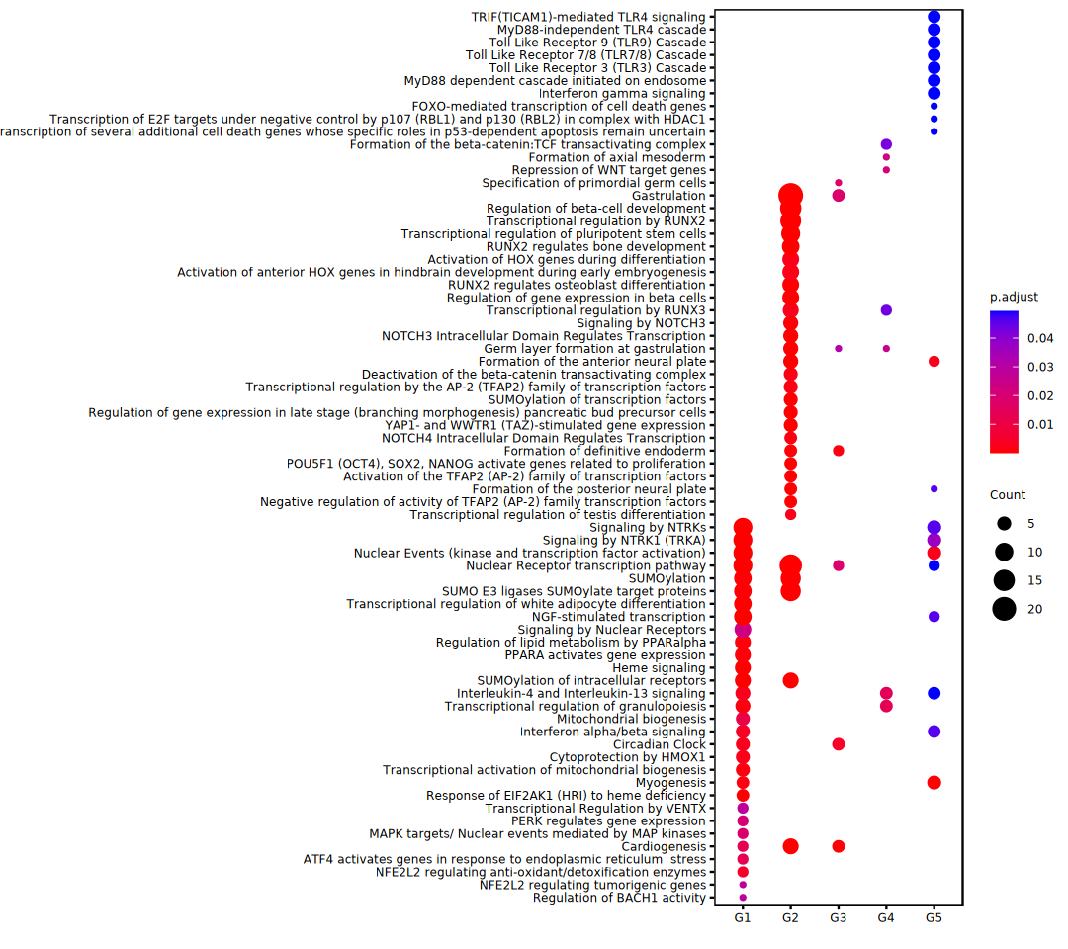
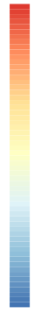
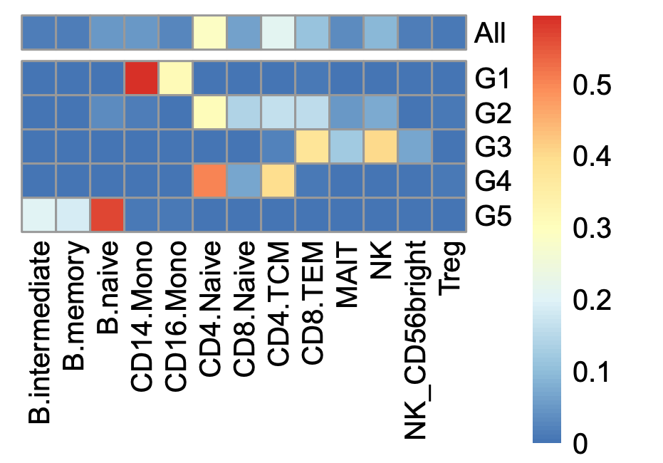
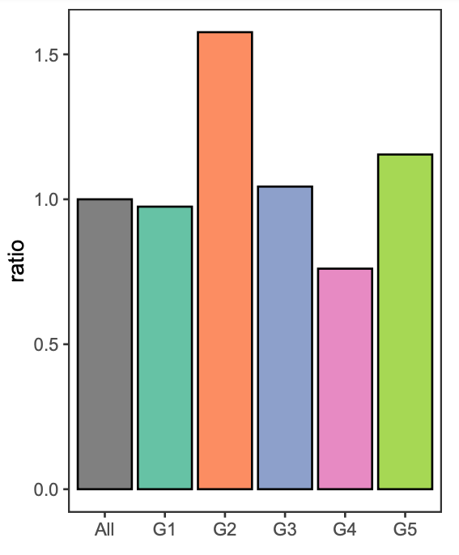
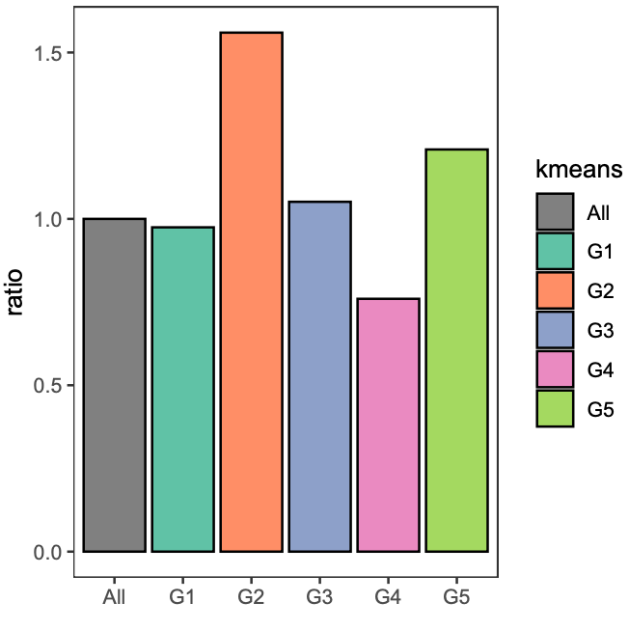
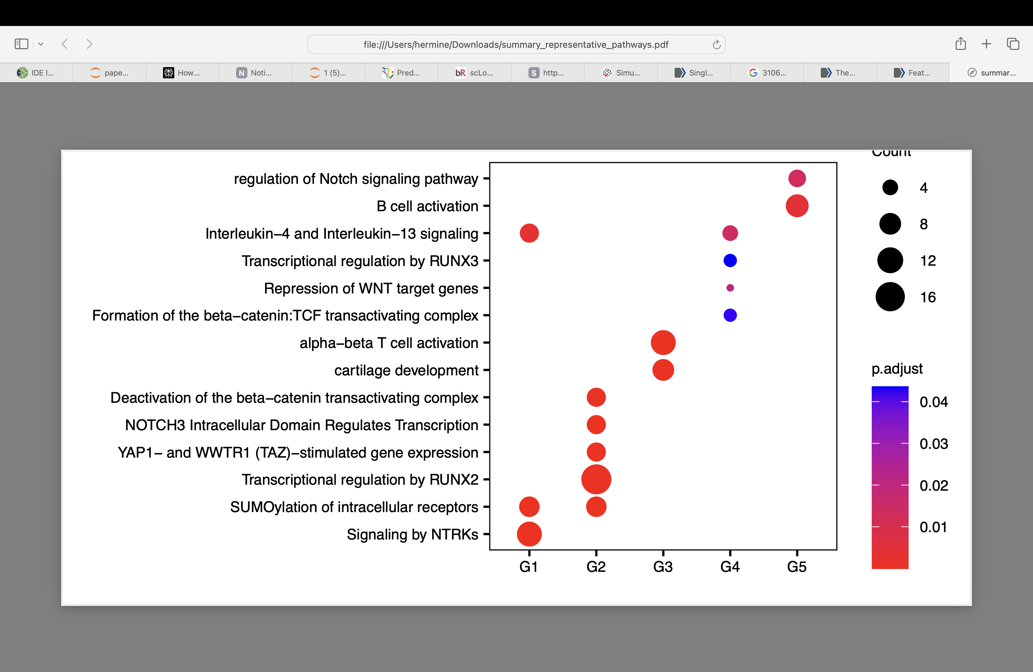
Fig. 2
A
Top 10 Kmeans group-specific TFs’ PageRanks
G1
G2
G3
G4
G5
KLF4
ZNF304
Group | # of specific TFs | # of clusters
G1 | 141 | 131
G2 | 409 | 359
G3 | 65 | 290
G4 | 41 | 704
G5 | 101 | 126
total | 640 | 1610
EOMES
TBX21
LEF1
TCF7
SPIB
Cluster 2
Normalized PageRank scores
Cluster 1
-2
0
2
4
C
At-Risk/ERA vs CON ratio distribution
B
Cell type distribution
****
All
0.5
1.5
G1
G2
Percent of clusters
G3
0.25
G4
1
NK
G5
0
***
B naive
MAIT
Treg
CD8 TEM
B memory
CD4 TCM
CD14 Mono
CD16 Mono
CD4 T Naive
B intermediate
CD8 T Naive
NK_CD56bright
0.50
0
0
All
G1
G2
G3
G4
G5
D
Representative pathways of Kmeans group specific TFs
Regulation of Notch signaling pathway
B cell activation
Interleukin-4 and Interleukin-13 signaling
Transcriptional regulation by RUNX3
Repression of WNT target genes
Formation of the beta-catenin: TCF transactivating complex
Alpha-beta T cell activation
Cartilage development
Deactivation of the beta-catenin transactivating complex
NOTCH3 Intracellular Domain Regulates Transcription
YAP1- and WWTR1 (TAZ)-stimulated gene expression
Transcriptional regulation by RUNX2
SUMOylation of intracellular receptors
Signaling by NTRKs
Count
4
8
12
16
p.adjust
0.04
0.03
0.02
0.01
G1
G2
G3
G4
G5
Notes:
*p<=0.1
****p<=1e-4
Fig.2C, the o.g. one, try (non-CON - CON)/CON

Slide 3
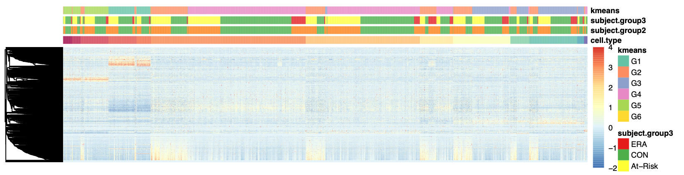
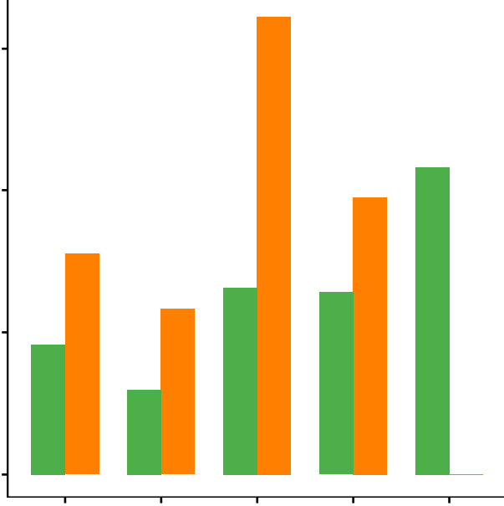
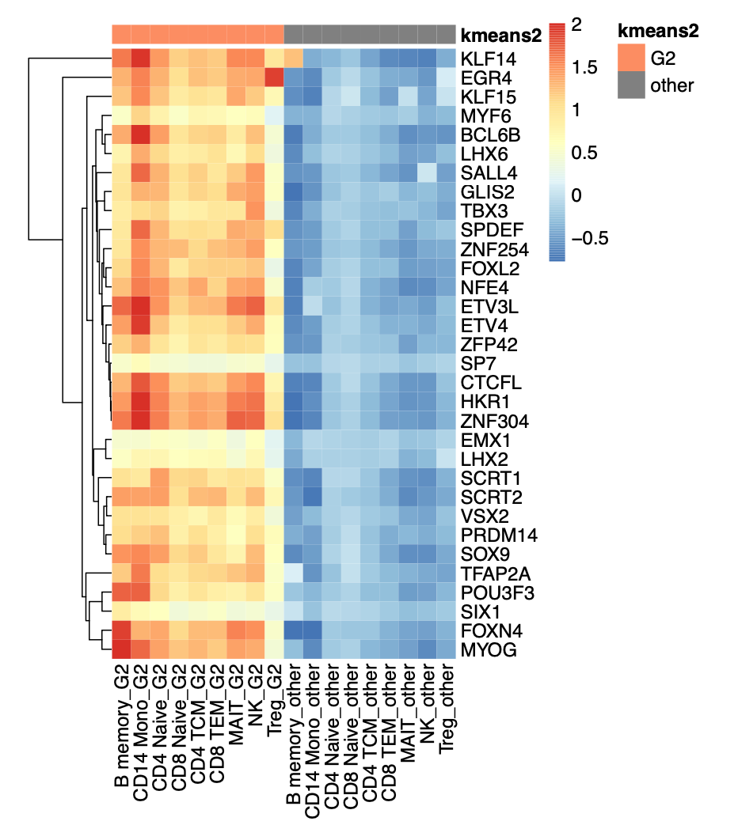
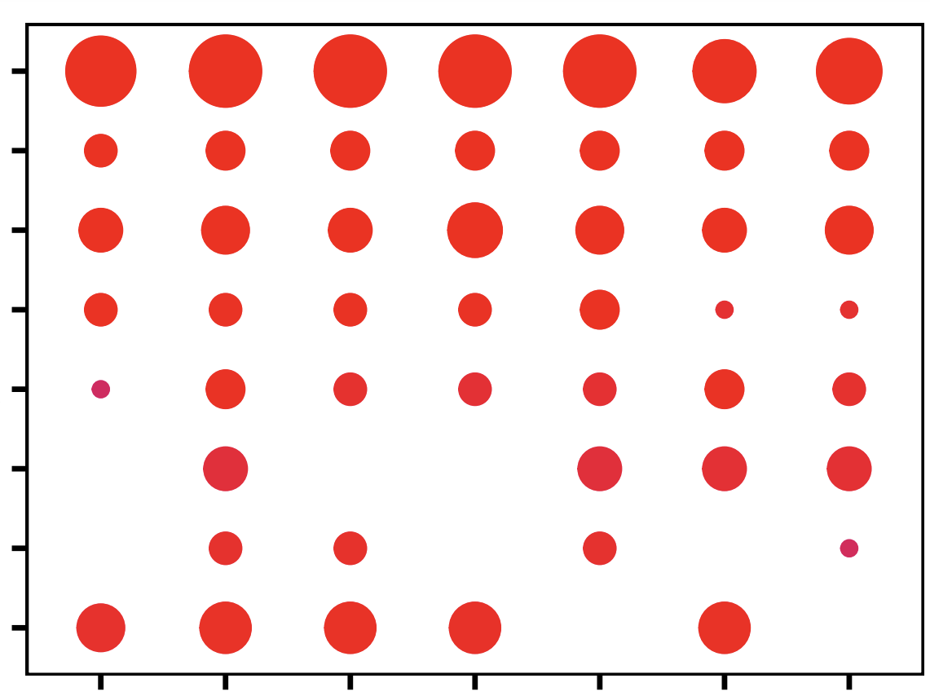
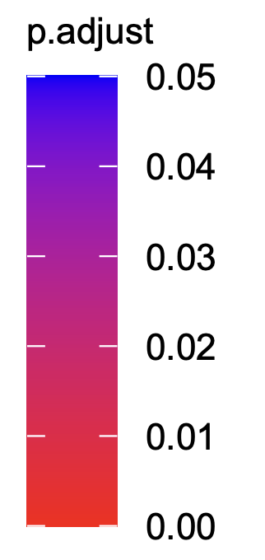
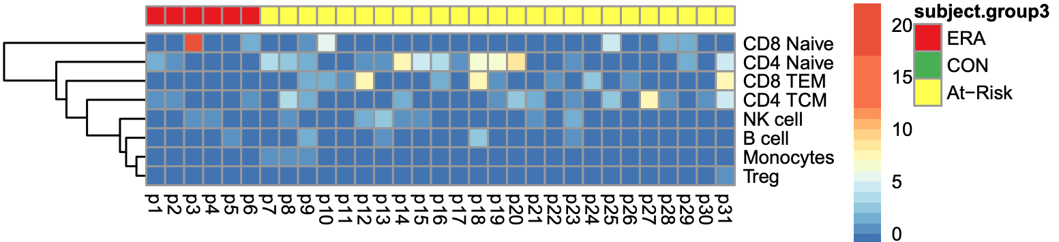
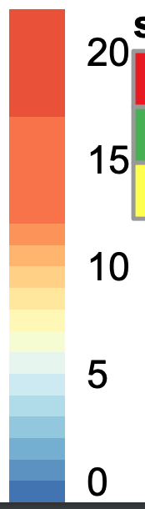
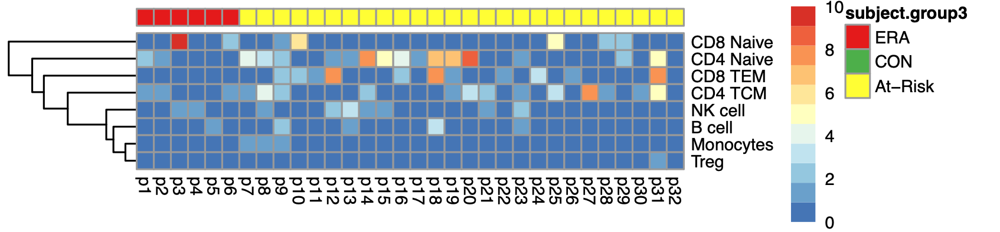
Fig. 3
A
Multiple cell types show signature
CD8 T Naive
B cell
Monocytes
CD4 T Naive
CD4 TCM
CD8 TEM
MAIT
NK cell
Treg
Normalized PageRank score
-2
0
2
4
Signature TFs
B
G2 clusters ratio per cell type in CON and At-Risk/ERA respectively
C
Mean PageRank of top G2-specific TFs across cell types
***
G2
other
KLF14
60
EGR4
40
*
***
CON
Normalized PageRank
Percentage of G2 clusters per cell type
***
At-Risk/ERA
2
20
ZNF304
1
B memory
CD14 Mono
CD4 T Naive
CD8 T Naive
CD4 TCM
CD8 TEM
MAIT
NK
Treg
B memory
CD14 Mono
CD4 T Naive
CD8 T Naive
CD4 TCM
CD8 TEM
MAIT
NK
Treg
0
0
CD4 T Naive
CD4 TCM
CD8 TEM
MAIT
MYOG
CD8 T Naive
D
Representative G2 pathways across cell types
Transcriptional regulation by RUNX2
count
p.adjust
YAP1- and WWTR1 (TAZ)-stimulated gene expression
4
SUMOylation of intracellular receptors
8
0.04
NOTCH3 Intracellular Domain Regulates Transcription
12
0.02
Deactivation of the beta-catenin transactivating complex
16
0
Transcriptional regulation by RUNX3
NGF-stimulated transcription
Activation of HOX genes during differentiation
B cell
CD4 TCM
CD8 TEM
NK cell
CD4 T Naive
CD8 T Naive
Monocytes
E
Heatmap of participants in G2 across cell types
ERA
At-Risk
Number of G2 clusters
CD8 T Naive
Number of G2 clusters
CD4 T Naive
>=10
CD8 TEM
0
5
10
15
20
CD4 TCM
5
NK cell
B cell
0
Monocytes
Treg
p10
p11
p12
p13
p14
p15
p16
p17
p18
p19
p20
p21
p22
p23
p24
p25
p26
p27
p28
p29
p30
p31
p1
p32
p2
p3
p4
p5
p6
p7
p8
p9
Notes:
Chi-squared test, *p < 0.5, **p < 0.05, ***p < 0.01.

Slide 4
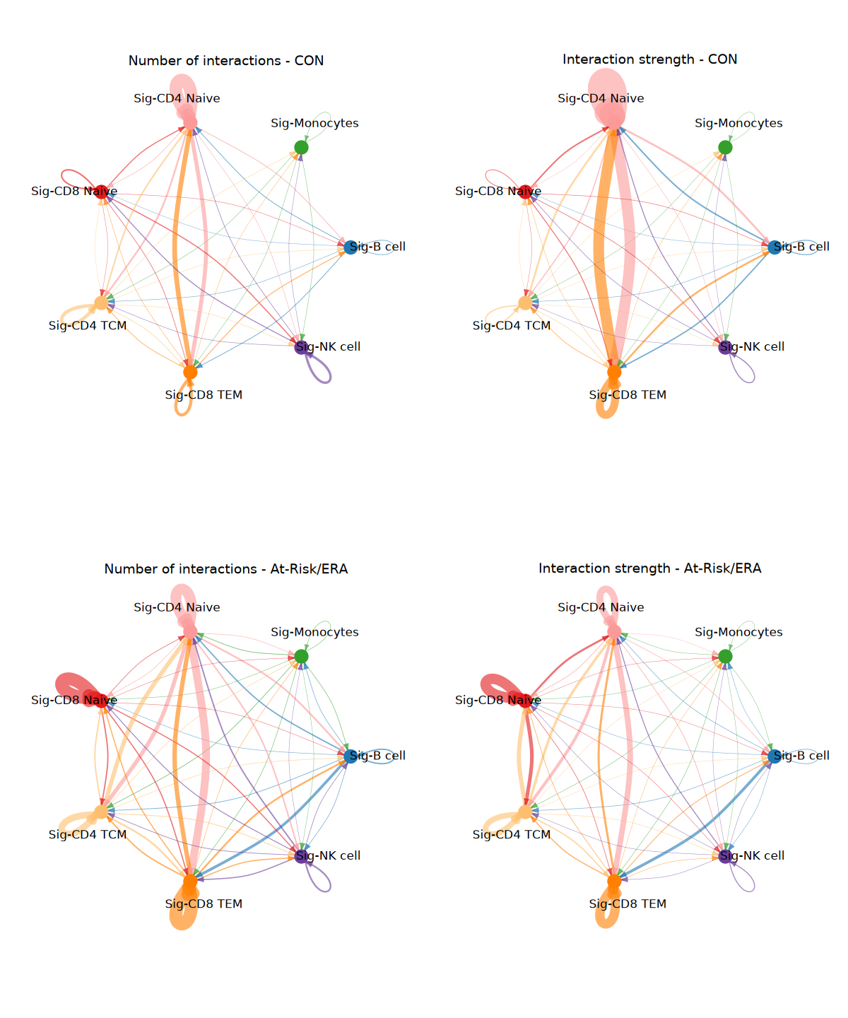
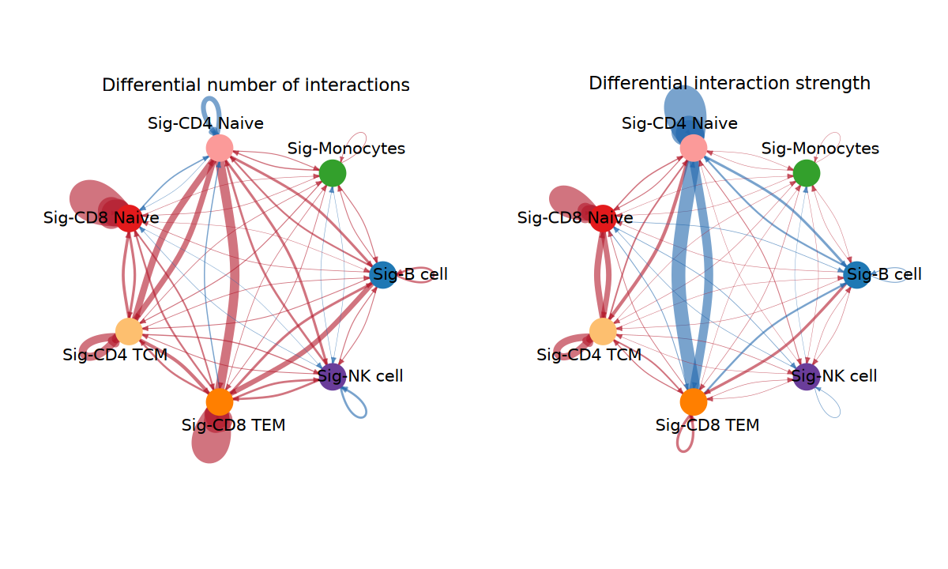
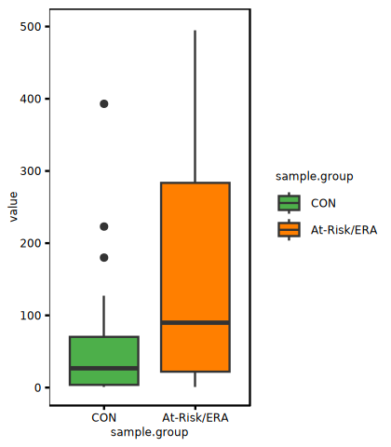
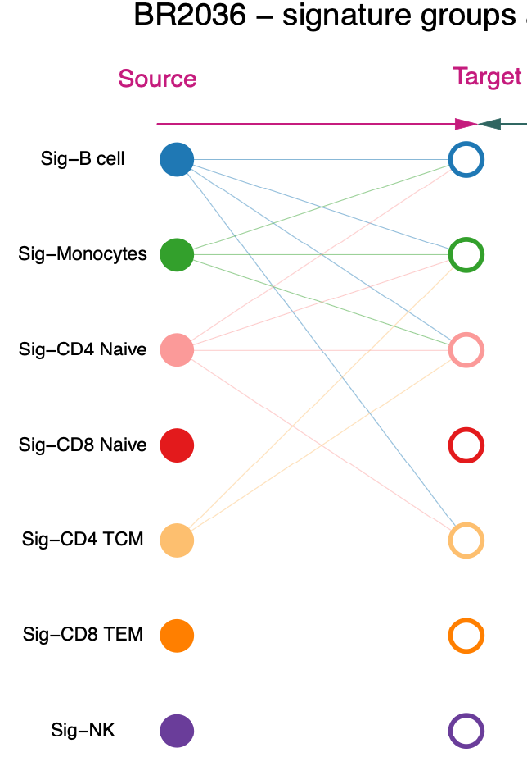
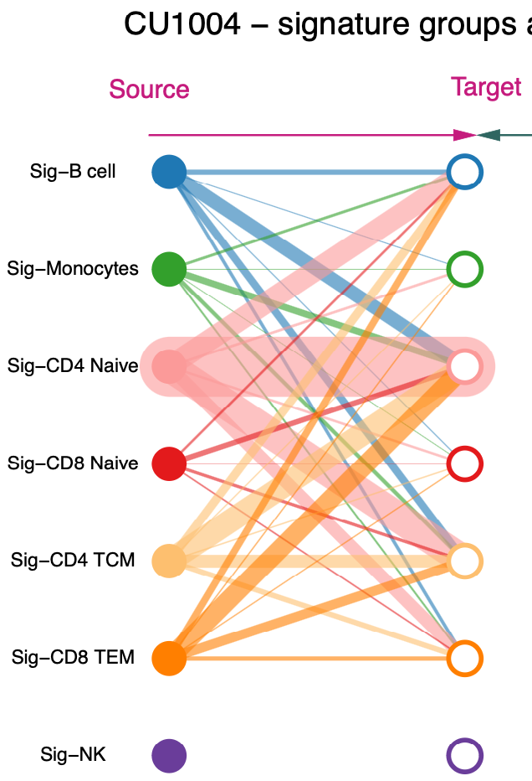
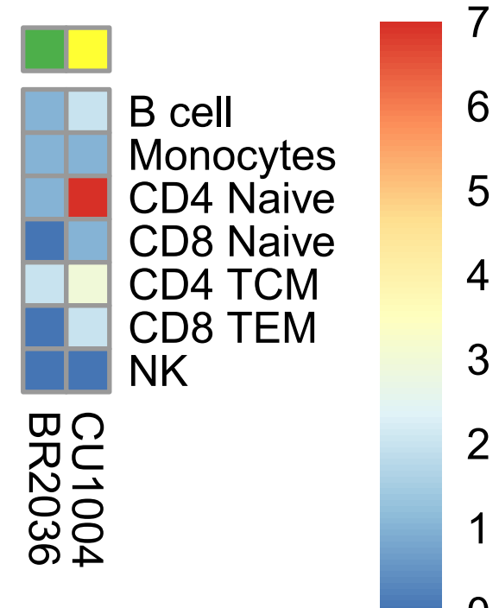
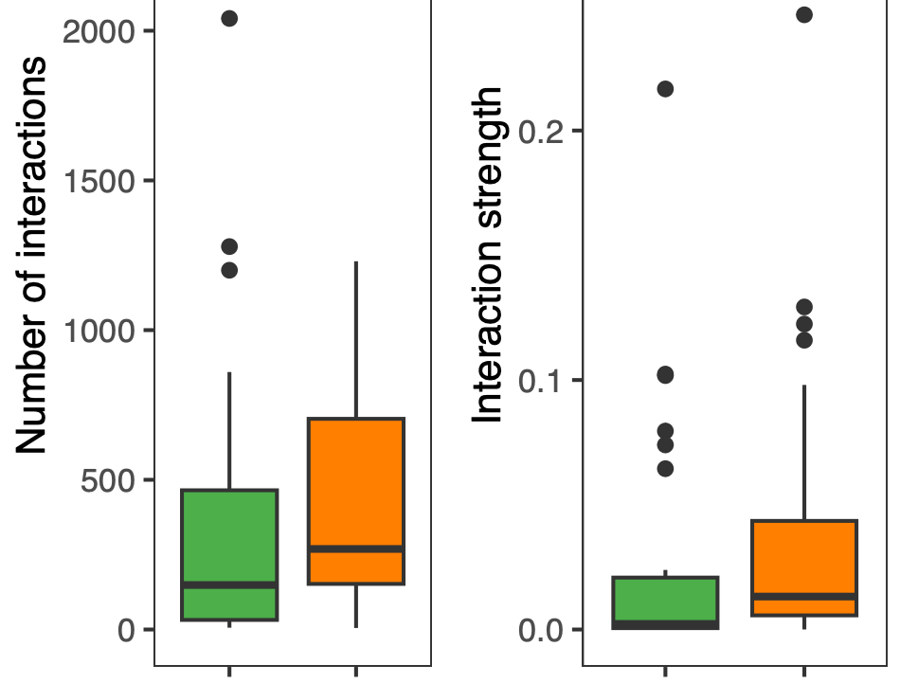
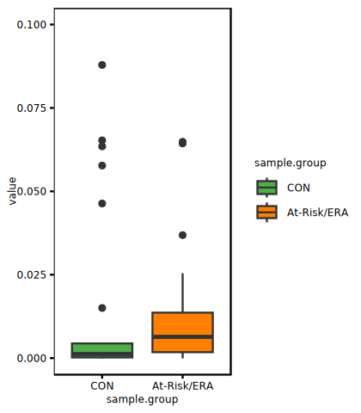
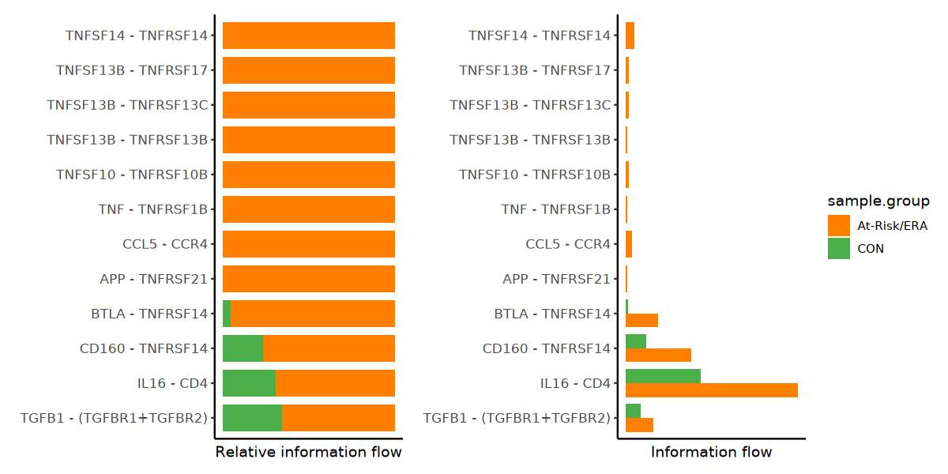
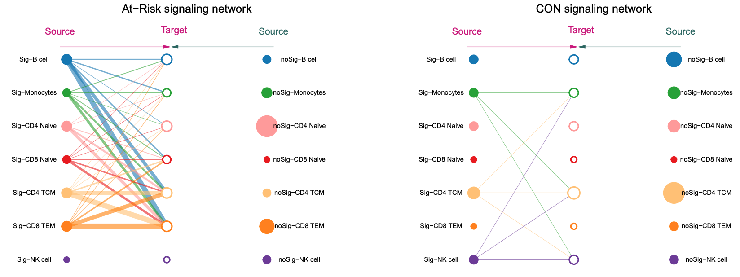
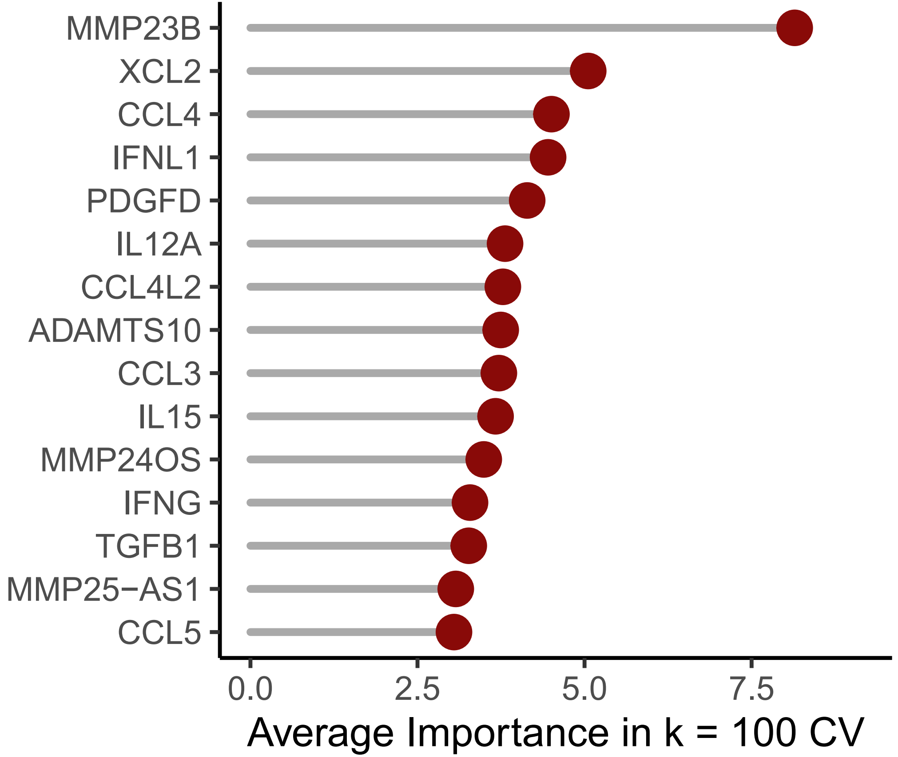
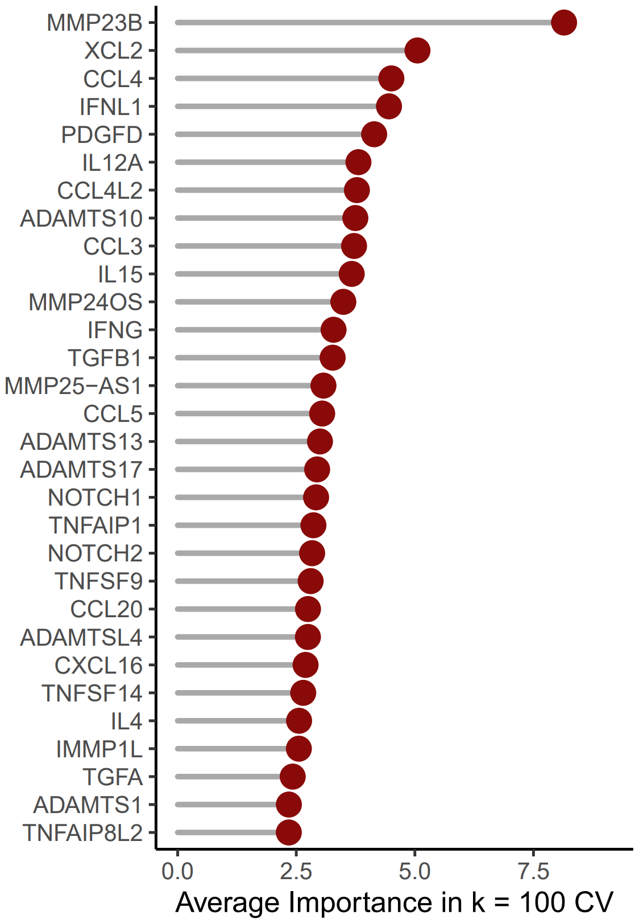
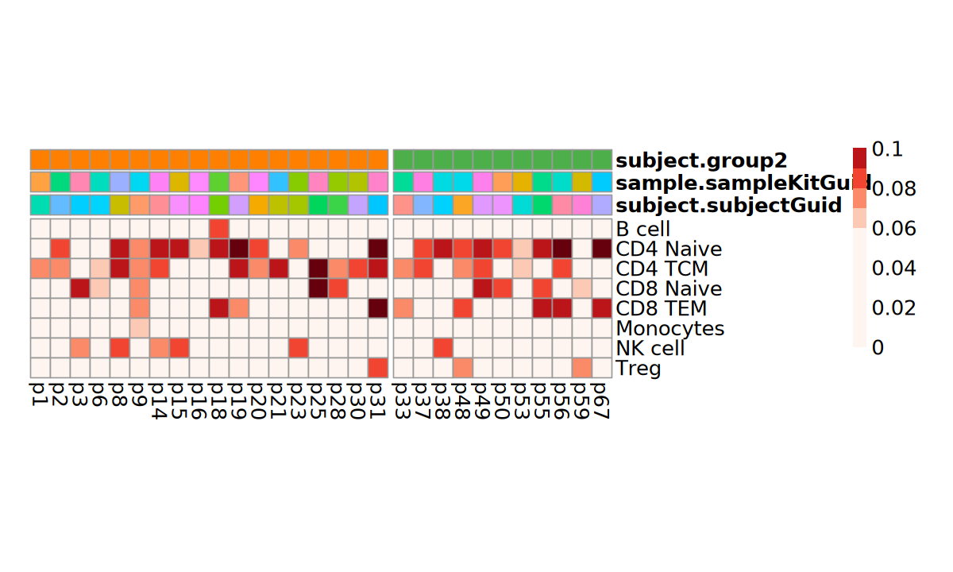
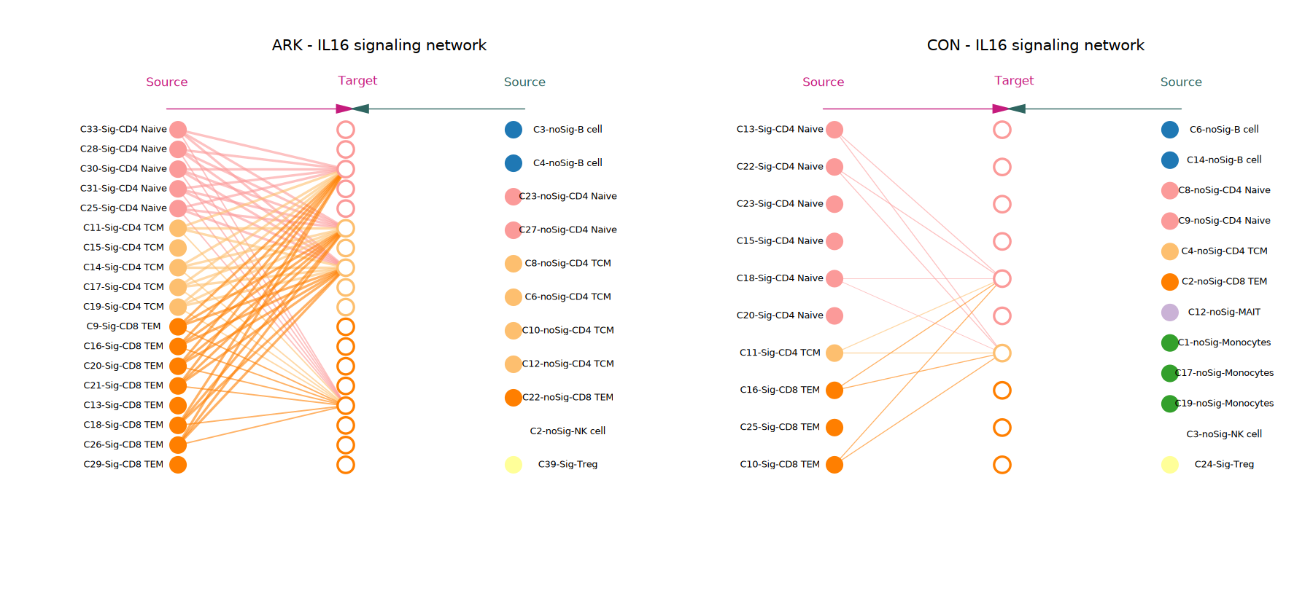
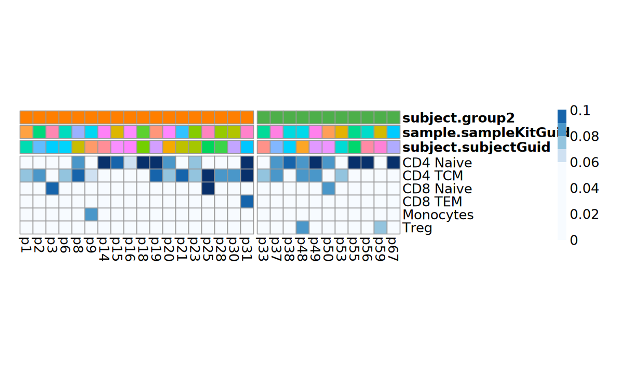
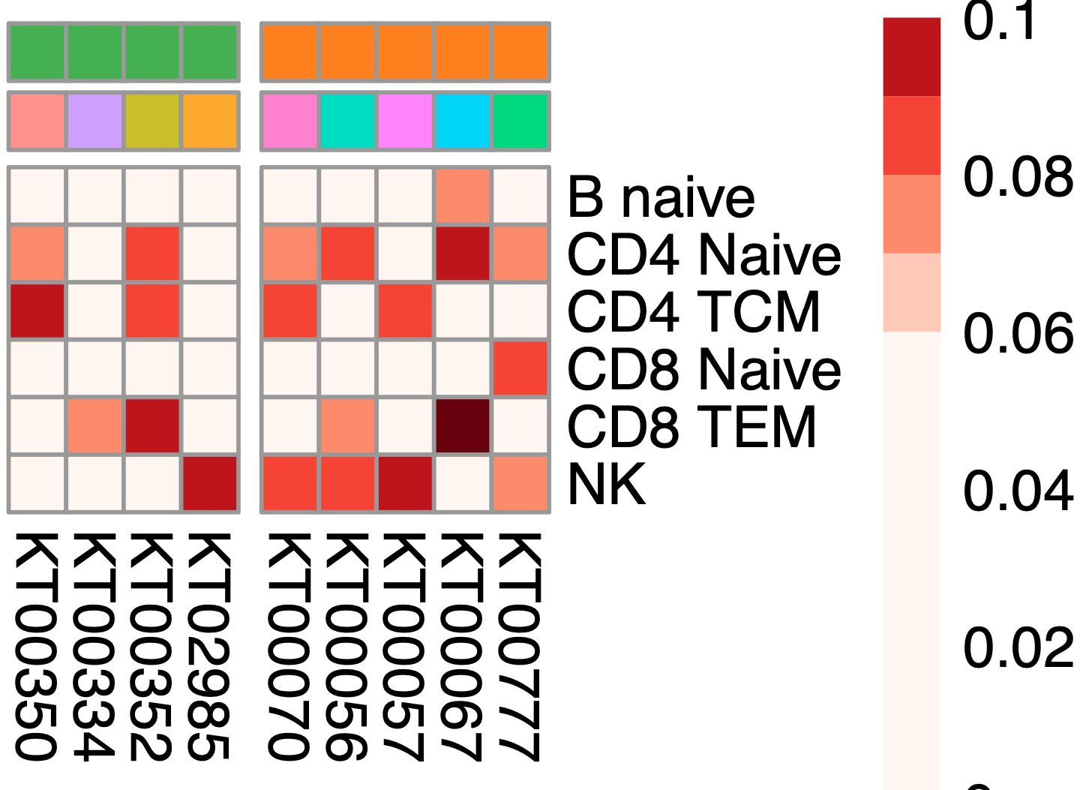

Fig. 4
A
Number of interactions between signature clusters in two groups
500
*
400
300
participant 53
participant
53
Number of interactions
participant 9
9
200
B cell
Source
Target
Source
Target
100
7
B cell
Monocytes
6
Monocytes
0
CD4 Naïve
5
CD4 Naïve
Number of pseudobulk clusters
CON
CD8 Naïve
4
CD8 Naïve
At-Risk/ERA
3
B
Network comparison within signature clusters
At-Risk/ERA
CON
At-Risk/ERA vs CON
CD4 TCM
2
CD4 TCM
CD8 TEM
1
CD8 TEM
B
Interaction strength between signature clusters in two groups
0.1
NK
0
NK
**
**
**
Interaction strength
0.05
0
CON
CON At-Risk/ERA
CON At-Risk/ERA
At-Risk/ERA
At-Risk/ERA
CON
At-Risk/ERA vs CON
C
Representative communication networks
D
Increased ligand-receptor pairs in At-Risk/ERA
p53
p9
TNFSF14 - TNFRSF14
CON
Source
Target
Source
Target
TNFSF13B - TNFRSF17
TNFSF13B - TNFRSF13C
At-Risk/ERA
B cell
TNFSF13B - TNFRSF13B
Monocytes
TNFSF10 - TNFRSF10B
E
Top predictors of classification model
CD4 T Naive
TNF - TNFRSF1B
CCL5 - CCR4
CD8 T Naive
APP - TNFRSF21
BTLA - TNFRSF14
CD4 TCM
CD160 - TNFRSF14
CD8 TEM
IL16 - CD4
NK cell
TGF-β1 - (TGFBR1+TGFBR2)
Relative information flow
Absolute information flow
E
IL16 signaling network comparison
F
Major senders/receivers in IL16 pathway
B
Source
p48
Target
Source
p31
Target
At-Risk/ERA
CON
B cell
CD4 Τ Naive
CD4 Τ Naive – C1
CD4 T Naive – C1
CD4 TCM
CD4 T Naive – C2
senders
CD8 Τ Naive
CD4 Τ Naive – C2
CD4 T Naive – C3
CD8 TEM
CD4 Τ Naive – C3
CD4 T Naive – C4
Monocytes
CD4 T Naive – C5
NK cell
CD4 Τ Naive – C4
CD4 TCM – C1
CD4 TCM – C2
CD4 Τ Naive
CD4 Τ Naive – C5
CD4 TCM – C3
CD4 TCM
CD4 TCM – C4
receivers
CD8 Τ Naive
CD4 Τ Naive – C6
CD4 TCM – C5
CD8 TEM
CD8 TEM – C1
Monocytes
CD4 TCM – C1
CD8 TEM – C2
p1
p2
p3
p6
p8
p9
p14
p15
p16
p18
p19
p20
p21
p23
p25
p28
p30
p31
p33
p37
p38
p48
p49
p50
p53
p55
p56
p59
CD8 TEM – C3
p67
CD8 TEM – C1
CD8 TEM – C4
Outgoing signaling strength
Incoming signaling strength
CD8 TEM – C5
CD8 TEM – C2
CD8 TEM – C6
CD8 TEM – C3
CD8 TEM – C7
CD8 TEM – C8
0
0.08
0.08
0.06
0.1
0
0.06
0.1
Notes:
CCL4, PDGFD, IL12A, IL15, TGFB1, CCL5, NOTCH1, CCL20, CXCL16, TNFSF14

Slide 5
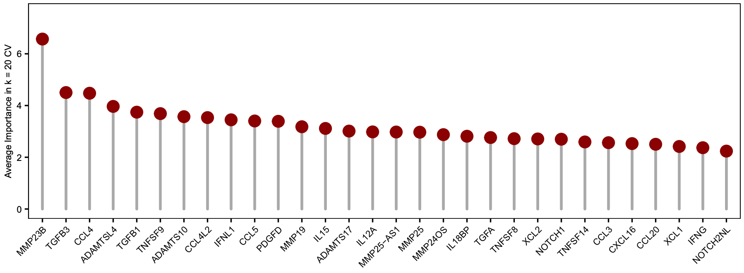
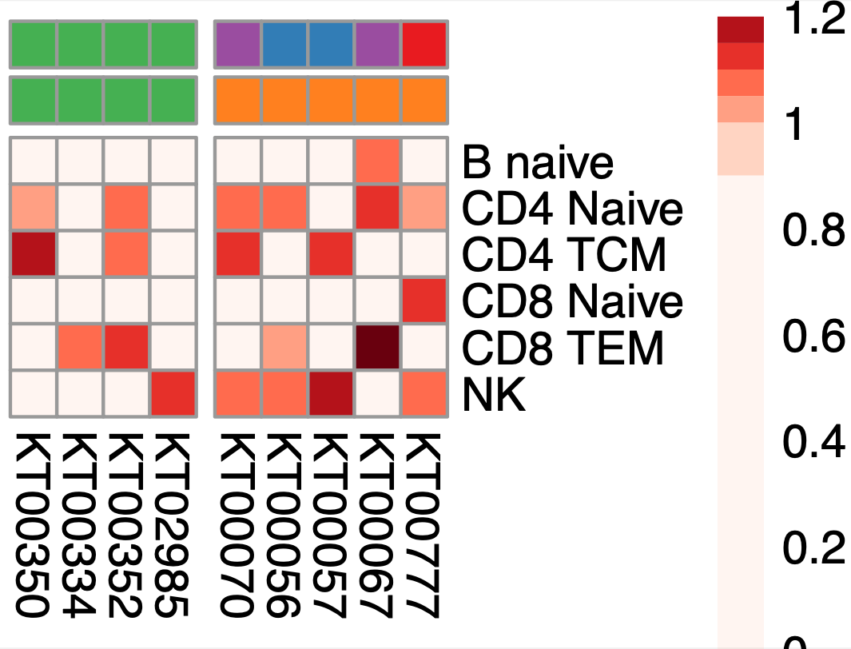
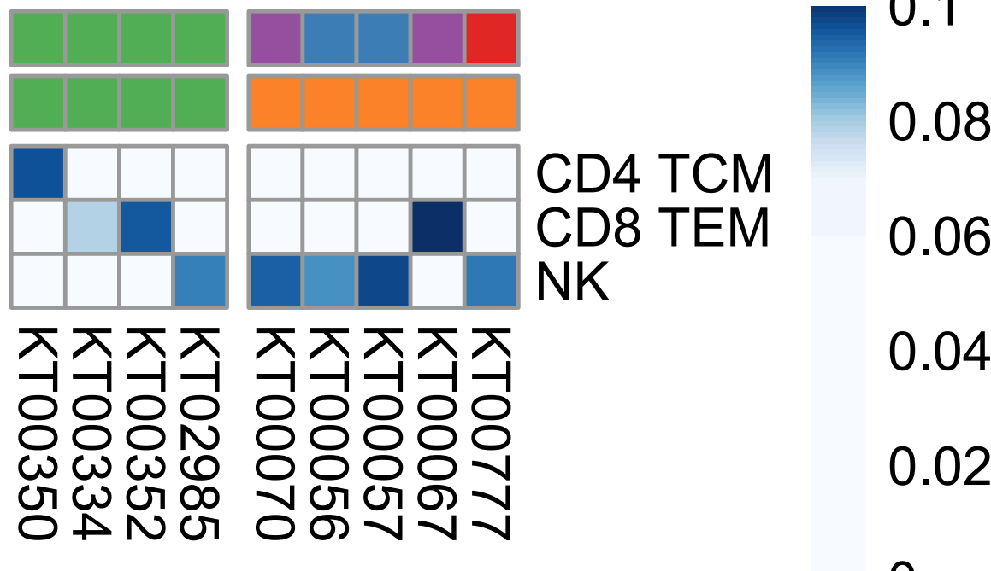
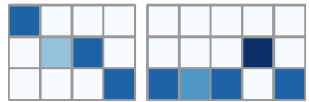
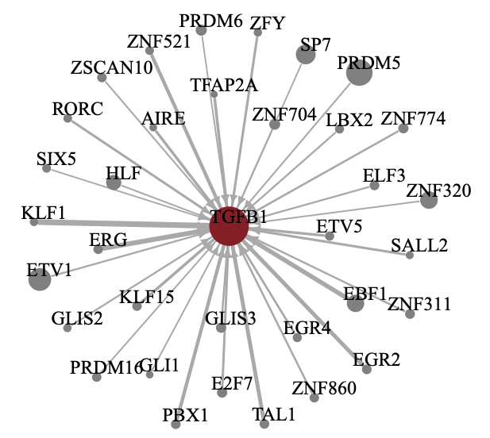
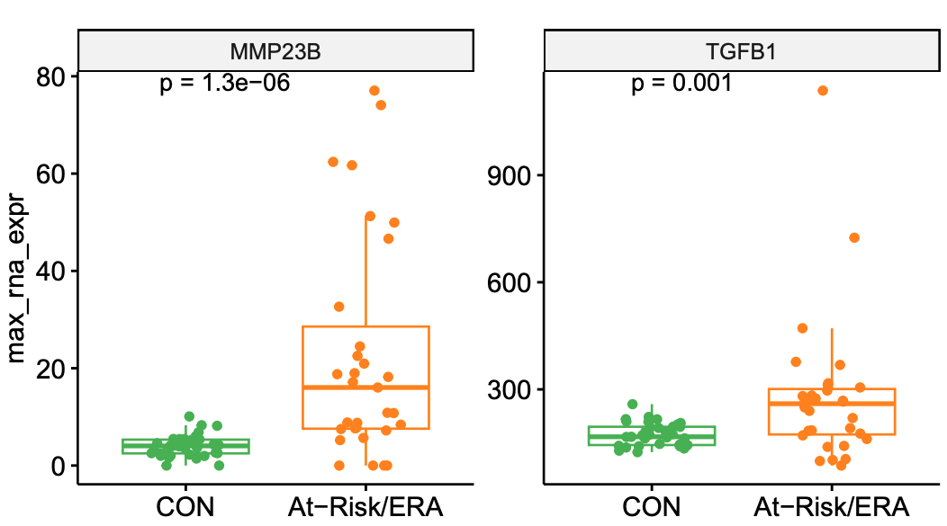
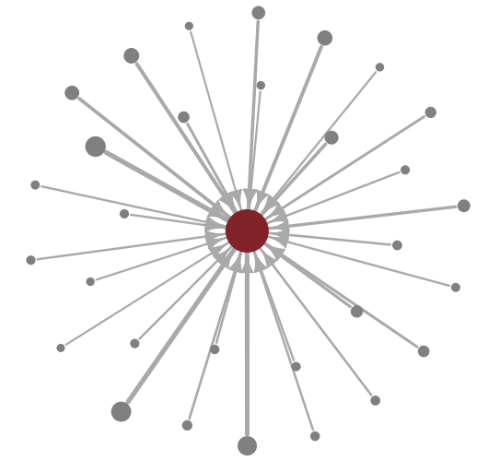
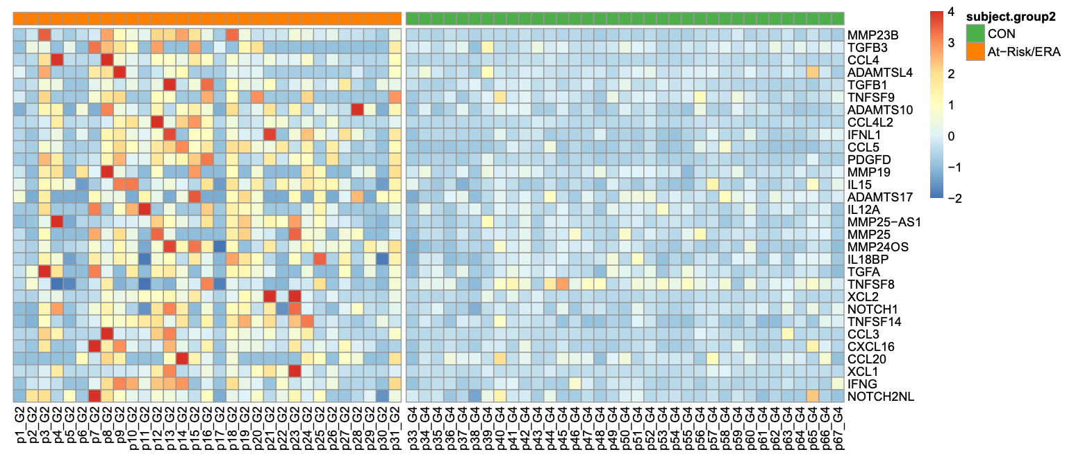
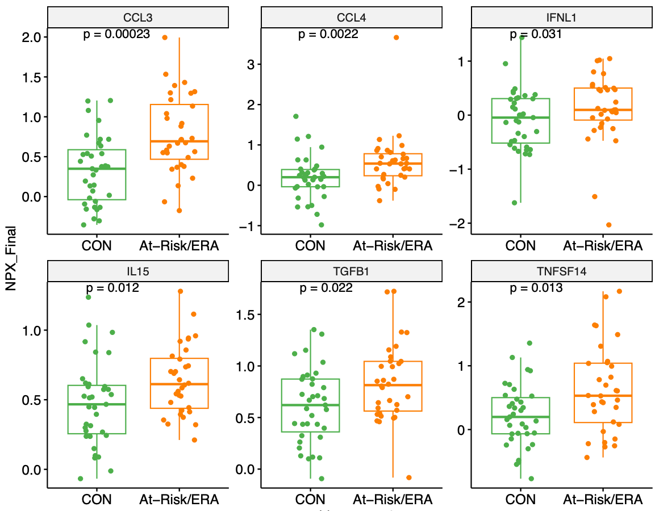
MMP23B
TGFB3
CCL4
ADAMTSL4
TGFB1
TNFSF9
ADAMTS10
CCL4L2
IFNL1
CCL5
PDGFD
MMP19
IL15
ADAMTS17
IL12A
MMP25-AS1
MMP25
MMP24OS
IL18BP
TGFA
TNFSF8
XCL2
NOTCH1
TNFSF14
CCL3
CXCL16
CCL20
XCL1
IFNG
NOTCH2NL
Fig. 5
A
Top 30 predictors of classification model
Major senders/receivers in TGF-β pathway
CON
At-Risk/ERA
42
47
48
65
8
11
12
6
participant#
18
3
Average Importance
B cell
4
CD4 Τ Naive
2
senders
CD4 TCM
CD8 Τ Naive
0
CD8 TEM
NK
CD4 TCM
receivers
CD8 TEM
NK
B
Gene expression of MMP23B
C
Gene TGFB1 expression level
D
Top regulators of TGFB1
80
****
****
TFAP2A
900
LHX8
WT1
60
SALL2
ZNF98
ZNF774
ZFY
600
ZNF662
ZBTB12
HNF4A
40
max_rna_expr
RORC
Max gene expression
ETV5
ZNF311
TGFB1
CTCFL
20
300
LBX
PRDM6
HNF4G
EGR4
0
ZSCAN1
ZNF695
ERG
AIRE
SP7
CON At-Risk/ERA
CON At-Risk/ERA
EGR2
ZNF704
KLF15
ALX3
GLIS3
PRRX2
E
Top 30 mediators’ gene expression levels
F
Protein expression of top mediators
KLF1
At-Risk/ERA
CON
CCL3
CCL4
IFN-λ1
MMP23B
TGFB3
CCL4
ADAMTSL4
TGFB1
TNFSF9
ADAMTS10
CCL4L2
IFNL1
CCL5
PDGFD
MMP19
IL15
ADAMTS17
IL12A
MMP25-AS1
MMP25
MMP24OS
IL18BP
TGFA
TNFSF8
XCL2
NOTCH1
TNFSF14
CCL3
CXCL16
CCL20
XCL1
IFNG
NOTCH2NL
1.5
****
3
***
1
**
1.0
2
0
0.5
1
-1
Normalized
gene expression
0.0
0
-2
4
Normalized protein expression
-1
2
IL-15
TGF-β1
TNFSF14
0
**
1.5
**
2
**
-2
1.0
1.0
1
0.5
0.5
0
0.0
0.0
CON
At-Risk/ERA
Notes:
Regulatee: TF’s regulatee in C2 non-CON samples
Fig.4B, just unbiased way to select TFs, like select solely by –values
Focus on one pathway, and find out which group of TFs
NOTCH3 is extremely important, RUNX2,

Slide 6




















Fig. 6
A
Top 30 mediators’ gene expression levels in synovial tissues across clusters
B
Top 30 mediators’ gene expression levels in synovial tissues across samples
C
Top 30 mediators’ gene expression levels across cell types in synovial tissues
All donors
C
Top 30 mediators’ gene expression levels in synovial tissues across clusters
Donor BRI-570
C
Mean gene expression levels in cell types across samples
Z-score
No scaling
D
Proposed hypothesis to RA onset
Cells with RA TF signature deliver increased pro-inflammatory mediators
Signature cells migrate to joint
Signature pathways via epigenetic remodeling in multiple cell types
At-Risk/ERA
control
Diverse cell types and mechanisms lead to common phenotype of RA
Monocytes
MMP23B
Healthy
B cell
TGFB1
Monocytes
NK
NOTCH1
CCL5
NK
RA Signature TFs, e.g. SUMOylation, RUNX2, YAP1, NOTCH3, and β-Catenin
Pathogenic genes
Gene/protein expression
IL15
B cell
CD4 T Naive
CD4 TCM
CD4 T Naive
CD8 T Naive
CD4 T Naive
CD4 TCM
CD8 TEM
CD8 T Naive
patient 1
CD8 TEM
patient 2
NK
CD4 TCM
CD8 TEM
C
TGFB1 gene expression levels in synovial tissues across donors
Risk factors
Genetics
Epigenetics
Environment (e.g., smoking)
Anti-citrullinated protein antibodies
B cell
Individualized cellular communication
Notes:
(a) Heatmap of gene expression in pseudo-bulk clusters in synovium tissues. Color represents the average normalized expression across cells in the cluster, scaled for each gene across clusters.

Slide 7












Fig. S1 Quality control summary for scRNA-seq and scATAC-seq
A
QC metrics for scRNA-seq
A
scRNA-seq and scATAC-seq of one control sample
scRNA-seq only
scATAC-seq only
B memory
B naive
CD14 Mono
CD16 Mono
CD4 T Naive
CD4 TCM
CD8 T Naive
CD8 TEM
MAIT
NK
Treg
UMAP 2
UMAP 2
B
UMAP plots from all scRNA-seq cells
Sample
Cell types
UMAP 1
UMAP 1
B
Co-embedding of scRNA-seq and scATAC-seq in one control sample
colored by cell types
colored by assay
scATAC-seq
scRNA-seq
C
QC metrics for scATAC-seq
UMAP 2
UMAP 2
D
Cells distribution in CD4 TCM cluster
Treg
MAIT
UMAP 1
UMAP 1
CD8 TEM
CD4 T Naive
D
UMAP plots from all scATAC-seq cells
E
Cluster purity across cell types
CD8 T Naive
Sample
Cell types
1.0
CD4 TCM
0.8
purity
0.6
0.4
B intermediate
B memory
B naive
CD14 Mono
CD16 Mono
CD4 T Naive
CD4 TCM
CD8 T Naive
CD8 TEM
cDC2
MAIT
NK
NK_CD56bright
Treg
Notes:
B112_PB00447

Slide 8









Fig. S2 Unsupervised clustering based on PageRank scores
A
Dimensional reduction
B
First several PCs are related cell types
C
Choose distance metric and number of groups
1
B intermediate
B memory
B naive
CD14 Mono
CD16 Mono
CD4 T Naive
CD4 Proliferating
CD4 TCM
CD4 TEM
CD8 T Naive
CD8 TCM
CD8 TEM
cDC2
Eryth
gdT
HSPC
MAIT
NK
NK_CD56bright
pDC
Plasmablast
Treg
K=5, Pearson Correlation
0.75
PC=500
distance metrics
Cumulative proportion of variance explained
0.10
Euclidean
0.50
PC2: 5% variance
Kendall
average silhouette width
Manhattan
0.25
0.05
Pearson
At-Risk
Spearman
CON
0
0
250
500
750
1000
PC1: 6% variance
ERA
5
10
Principal Component
number of groups K
D
Kmeans clustering: all TFs
G1
G2
G3
G4
G5
Normalized PageRank
4
2
0
-2
E
Kmeans group-specific TFs
F
Overlap of G2-specific TFs
H
G2 clusters ratio per cell type
At-Risk
ERA
38
398
4
CON
At-Risk/ERA
G
Overlap of G2-specific pathways
CON
ERA
At-Risk/ERA
At-Risk
2
18
2
CON
At-Risk/ERA
Percentage of G2 clusters per cell type

Slide 9








Fig. S3 Unsupervised clustering across cell types
A
Heatmap of participants in G2 across cell types
ERA
At-Risk
CON
ARID3C
ARX
BARHL2
BCL6B
CDX1
DBX2
DLX1
DLX2
DLX3
DLX5
DPF1
DUX4
E2F7
E2F8
EGR4
ELF5
EMX1
EN2
ETV1
ETV3L
ETV4
FOXD4L1
FOXD4L5
FOXL2
FOXP2
GCM1
GCM2
GLIS2
HAND1
HKR1
HMX2
HOXA13
HOXB13
IRX5
KLF14
KLF15
LHX8
LIN28A
MEF2B
MIXL1
MLXIPL
MNX1
NFE4
NKX2-2
NOBOX
NOTO
PAX2
PAX4
PAX7
PHOX2A
POU1F1
POU2F3
POU3F2
POU3F3
POU3F4
PROP1
PRRX1
PRRX2
RAX2
RHOXF2
RHOXF2B
SHOX
SHOX2
SIX1
SIX4
SOHLH2
SP7
SP9
TBPL2
TFAP2A
TFAP2B
TFAP2C
TFDP3
TLX2
TP63
VSX2
WT1
YBX2
ZIC1
ZNF177
ZNF214
ZNF304
ZNF454
CD8 T Naive
CD4 T Naive
CD8 TEM
CD4 TCM
NK cell
B cell
Monocytes
Treg
C
Representative pathways of Kmeans group specific regulatees
Nuclear Receptor transcription pathway
Interferon signaling
TNF signaling
Regulation of RUNX2 expression and activity
SUMOylation
Signaling by ROBO receptors
G alpha (q) signaling events
Number of G2 clusters
0
5
10
15
20
B
G2-specific TFs whose regulatees enriched in At-Risk/ERA signature pathways
B
G2-specific TFs whose regulatees enriched in At-Risk/ERA signature pathways
G1
G2
G3
G5
TNF
SUMO
RUNX2
ROBO
NOTCH3
NF-kB
beta-catenin
E
Regulatees in signature pathways
Intersection
size
30
20
10
0
C
Downstream genes of SUMOylation-related TFs
D
TFs in signature pathways
ROBO
SUMO
NF-kB
RUNX2
TNF
HEY1, HEY2, HES1
Set size
D
TFs in signature pathways
16
HEY1, HEY2, HES1
SATB2, AR
Intersection
size
10
SOX9
5
0
RUNX2
SUMO
YAP Wnt
NOTCH3
Set size

Slide 10















Fig. S4 Cellular network analysis
A
Overall signaling network comparison
B
Differential cellular network between two groups
9000
1.5
6000
1.0
Number of interactions
Interaction strength
3000
0.5
0
CON At-Risk/ERA
0.0
CON At-Risk/ERA
B
Major senders/receivers across patients
At-Risk/ERA
CON
B cell
E
CCL5 signaling network comparison
CD4 T Naive
CD4 TCM
senders
CD8 T Naive
participant 25
participant 40
D
CD8 TEM
Monocytes
Source
Target
Source
Target
NK cell
Incoming signaling strength
B cell
Outgoing signaling strength
CD4 T Naive
receivers
CD4 TCM
CD8 T Naive
CD8 TEM
Monocytes
NK cell
IL16 signaling network comparison
p55
p9
C
TGF-β signaling network comparison
D
Major senders/receivers in TGF-β pathway
Source
Target
Source
Target
Source
p48
Target
Source
p18
Target
CON
At-Risk/ERA
B cell – C1
B cell – C1
B cell – C1
B cell
CD4 T Naive – C1
CD4 T Naive – C1
B cell – C2
B cell – C2
CD4 T Naive – C2
B cell – C3
CD4 Τ Naive
Outgoing signaling strength
CD4 T Naive – C2
CD4 Τ Naive – C1
senders
CD4 TCM
CD4 T Naive – C1
CD4 T Naive – C3
CD4 Τ Naive – C2
CD8 Τ Naive
CD4 Τ Naive – C3
0
0.08
CD4 T Naive – C3
CD4 T Naive – C4
CD4 Τ Naive – C4
CD8 TEM
0.06
0.1
CD4 T Naive – C4
CD4 T Naive – C2
CD4 T Naive – C5
CD4 Τ Naive – C5
Monocytes
CD4 Τ Naive – C6
NK cell
**
**
CD4 T Naive – C5
CD4 T Naive – C6
CD4 Τ Naive – C7
CD4 TCM
Incoming signaling strength
CD4 T Naive – C6
CD4 TCM – C1
CD8 TEM – C1
CD8 TEM
CD4 TCM – C1
CD8 TEM – C2
receivers
CD8 TEM – C3
NK cell
0
0.08
CD4 T Naive – C7
CD4 TCM – C2
CD8 TEM – C1
CD8 TEM – C4
p42
p8
p3
0.06
0.1
p47
p48
CD8 T Naive – C1
CD8 TEM – C2
CD8 TEM – C5
p65
p18
CD8 T Naive – C1
CD8 TEM – C6
CD8 TEM – C1
CD8 TEM – C3
CD8 TEM – C7
CD8 TEM – C2
CD8 TEM – C1
CD8 TEM – C8
CD8 TEM – C3
CD8 TEM – C2
E
CD160 signaling network comparison
F
Major senders/receivers in CD160 pathway
CD8 TEM – C4
Source
p55
Target
Source
p18
Target
At-Risk/ERA
CON
CD8 TEM – C5
Monocytes – C1
B cell – C1
B cell – C1
CD4 TCM
CON At-Risk/ERA
CON At-Risk/ERA
CD8 TEM – C6
pDC – C1
CD4 Τ Naive – C1
B cell – C2
senders
CD8 TEM
CD4 Τ Naive – C2
B cell – C3
NK cell
CD4 Τ Naive – C3
CD4 Τ Naive – C1
B cell
CD4 Τ Naive – C4
CD4 Τ Naive – C2
CD4 Τ Naive – C3
CD4 Τ Naive
CD4 Τ Naive – C5
CD4 Τ Naive – C4
CD4 TCM
CD4 Τ Naive – C6
CD4 Τ Naive – C5
receivers
CD8 Τ Naive
CD4 Τ Naive – C7
CD4 Τ Naive – C6
CD8 TEM
CD8 Τ Naive – C1
CD4 Τ Naive – C7
CD8 TEM – C1
CD8 TEM – C1
NK cell
CD8 TEM – C2
p3
p4
p8
p14
p15
p18
p21
p24
p41
p42
p45
p47
p55
p57
CD8 TEM – C2
CD8 TEM – C3
p63
CD8 TEM – C3
CD8 TEM – C4
Outgoing signaling strength
Incoming signaling strength
CD8 TEM – C4
CD8 TEM – C5
CD8 TEM – C5
CD8 TEM – C6
CD8 TEM – C7
0
0.08
0.08
0.06
0.1
0
CD8 TEM – C6
CD8 TEM – C8
0.06
0.1
E
Notes:
https://www.ncbi.nlm.nih.gov/pmc/articles/PMC10439836/

Slide 11








Fig. S5 Unsupervised clustering based on gene expression
A
Classification model performance
MMP23B
TGFB3
CCL4
ADAMTSL4
TGFB1
TNFSF9
ADAMTS10
CCL4L2
IFNL1
CCL5
PDGFD
MMP19
IL15
ADAMTS17
IL12A
MMP25-AS1
MMP25
MMP24OS
IL18BP
TGFA
TNFSF8
XCL2
NOTCH1
TNFSF14
CCL3
CXCL16
CCL20
XCL1
IFNG
NOTCH2NL
B
Cell type distribution of top 30 mediators
1.0
0.9
0.8
0.7
0.6
0.5
CD8 T Naive
CD4 T Naive
CD4 TCM
Group
Treg
Mean +/ SD Accuracy
test
train
B cell
Monocytes
NK
CD8 TEM
Normalized probability
0
20
40
60
0.4
Number of Predictors
0.2
0
G
cell type distribution
C
TGFB1 gene expression levels across individuals
MMP23B
XCL2
CCL4
IFNL1
PDGFD
IL12A
CCL4L2
ADAMTS10
CCL3
IL15
MMP24OS
IFNG
TGFB1
MMP25-AS1
CCL5
ADAMTS13
ADAMTS17
NOTCH1
TNFAIP1
NOTCH2
TNFSF9
CCL20
ADAMTSL4
CXCL16
TNFSF14
IL4
IMMP1L
TGFA
ADAMTS1
TNFAIP8L2
B cell
CD4 T Naive
CD4 TCM
CD8 T Naive
CD8 TEM
Monocytes
NK cell
Normalized
gene expression
0.6
4
2
0.4
0
Normalized probability
-2
0.2
p10
p11
p12
p13
p14
p15
p16
p17
p18
p19
p20
p21
p22
p23
p24
p25
p26
p27
p28
p29
p30
p1
p31
p2
p3
p4
p5
p6
p7
p8
p9
0
Choose distance metric and number of groups
Disease state distribution across Kmeans group
D
E
K=5, Pearson Correlation
0.20
distance metrics
average silhouette width
Euclidean
0.10
Kendall
NK
Treg
Manhattan
CD8 TEM
B cell
CD4 TCM
Monocytes
CD8 T Naive
Pearson
CD4 T Naive
0
Spearman
5
10
number of groups K
F
Kmeans clustering by gene expression matrix
G1
G2
G3
G4
G5
Protein expression levels
Normalized PageRank
4
2
0
-2
TNFSF14
IL15
CCL3
TGFB1
CCL4
Notes:
(C) Protein expression level of TGF-β1 in each individual. At-Risk/ERA has significantly higher protein expression level than control.
(D) Gene expression level of TGFB1 in each individual. At-Risk/ERA has significantly higher gene expression level

Slide 12





Fig. xx Signature in external dataset
A
Hierarchical clustering of pseudo-bulk clusters from five established RA samples
B
Heatmap of RAs in signature clusters
CD8 TEM
6
CD4 TEM
5
CD4 TCM
4
To explore whether the At-Risk/ERA signature persists in later development stage of RA, we gathered five established RA PBMC samples and applied the same analysis pipeline to get the PageRank scores of TFs across pseudo-bulk clusters from established RAs. Hierarchical clustering demonstrates that a group of TFs have high PageRank scores in specific clusters (Supplementary Fig. xxA), referred to as “Established RA signature TFs” and “Established RA signature clusters”. All the five RA participants had the signature in at least one cell type although the combinations of cell types were diverse (Supplementary Fig. xxB). Participants RA3, RA4, and RA5 showed similar signature profiles, in which CD4 T Naive, CD14 Mono, and NK cells were enriched. Comparison of signature TFs identified from At-Risk/ERA and established RA datasets showed a significant overlap (Supplementary Fig. xxC) as well as the enriched Reactome pathways (Supplementary Fig. xxD). All the signature pathways identified in At-Risk/ERA dataset were recovered in the established RA dataset. To further confirm the At-Risk/ERA signature presence in established RAs, we trained a random forest classification model to distinguish signature clusters and non-signature clusters. At-Risk/ERA TF PageRank scores were used as features and clusters from At-Risk/ERA dataset were used as samples. Mean accuracy is 0.94$±$0.01 over 20 cross-validations for both test and train groups (Supplementary Fig. xxE). The trained model on the external established RA samples showed good performance with accuracy as 0.91 (Supplementary Fig. xxF).
Number of signature clusters
CD4 T Naive
3
CD14 Mono
2
NK
1
RA1
0
RA2
RA3
RA4
RA5
Established RA
signature TFs
C
Signature TF overlap
Established RA
At-Risk/ERA
94
276
157
D
Enriched pathways overlap
Established RA
At-Risk/ERA
5
27
19
Fig. xx Signature confirmation in external established RA dataset. (A) Hierarchical clustering of pseudo-bulk clusters from five established RA samples. The heatmap shows the normalized PageRank scores of all TFs across all clusters, including B naive, CD14 Mono, CD4 CTL, CD4 Naive, CD4 TCM, CD4 TEM, CD8 Naive, CD8 TEM, and NK cells. A group of TFs are significantly active in a group of clusters, referred to as “Established RA signature TFs” and “Established RA signature clusters”, marked by red boxes. (B) Heatmap of established RA participants in signature clusters across cell types. All the RA participants had the signature in at least one cell type. The signatures were enriched in CD4 T Naive, CD14 Mono and NK cells. (C, D) Venn diagram showing the overlap of signature transcription factors (C) and signature pathways (D) between established RA and At-Risk/ERA groups. (E) Performance of a classification model to distinguish signature (sig) clusters from non-signature (no-sig) clusters using a varying number of predictors. The model was trained on the At-Risk/ERA dataset and the plot displays mean accuracy with standard deviation over 20 cross-validations for both test and train groups. (F) Confusion matrix for prediction on the established RA dataset.
Established RA
signature clusters
E
Random forest classification model
F
Prediction on established RA dataset
0.95
0.90
0.85
0.80
0.75
sig
31
8
Freq
metric | value
accuracy | 0.91
sensitivity | 1
specificity | 0.79
Mean +/ SD Accuracy (k=20 CV)
Group
prediction
40
test
train
20
no-sig
0
50
0
0
10
20
30
sig
no-sig
Number of Predictors
reference

